Slide 1
badges
Taught by Yossef Ayman Zedan

Slide 2
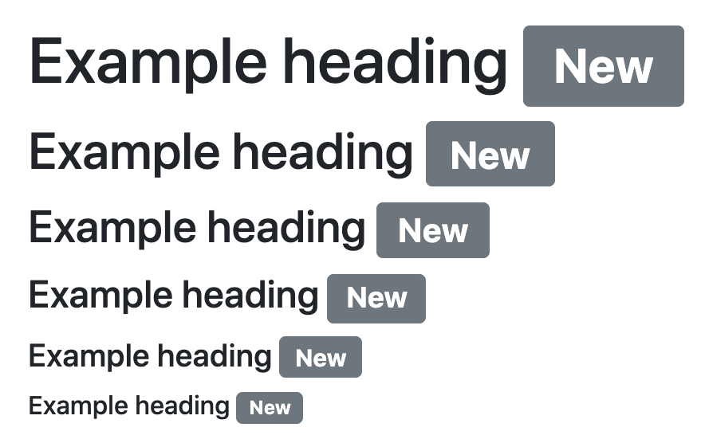
Headings
<h1>Example heading <span class="badge bg-secondary">New</span></h1> <h2>Example heading <span class="badge bg-secondary">New</span></h2> <h3>Example heading <span class="badge bg-secondary">New</span></h3> <h4>Example heading <span class="badge bg-secondary">New</span></h4> <h5>Example heading <span class="badge bg-secondary">New</span></h5> <h6>Example heading <span class="badge bg-secondary">New</span></h6>

Slide 3
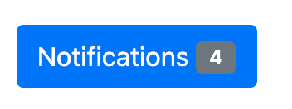
Buttons
Badges can be used as part of links or buttons to provide a counter.
<button type="button" class="btn btn-primary"> Notifications <span class="badge bg-secondary">4</span> </button>
Note that depending on how they are used, badges may be confusing for users of screen readers and similar assistive technologies. While the styling of badges provides a visual cue as to their purpose, these users will simply be presented with the content of the badge. Depending on the specific situation, these badges may seem like random additional words or numbers at the end of a sentence, link, or button.
Unless the context is clear (as with the “Notifications” example, where it is understood that the “4” is the number of notifications), consider including additional context with a visually hidden piece of additional text.

Slide 4
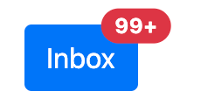
Buttons
Positioned
Use utilities to modify a .badge and position it in the corner of a link or button.
<button type="button" class="btn btn-primary position-relative"> Inbox <span class="position-absolute top-0 start-100 translate-middle badge rounded-pill bg-danger"> 99+ <span class="visually-hidden">unread messages</span> </span> </button>

Slide 5
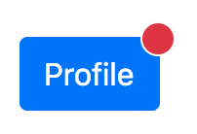
Buttons
You can also replace the .badge class with a few more utilities without a count for a more generic indicator.
<button type="button" class="btn btn-primary position-relative"> Profile<span class="position-absolute top-0 start-100 translate-middle p-2 bg-danger border border-light rounded-circle"> <span class="visually-hidden">New alerts</span> </span> </button>

Slide 6
Background colors
Use our background utility classes to quickly change the appearance of a badge. Please note that when using Bootstrap’s default .bg-light, you’ll likely need a text color utility like .text-dark for proper styling. This is because background utilities do not set anything but background-color.
<span class="badge bg-primary">Primary</span> <span class="badge bg-secondary">Secondary</span> <span class="badge bg-success">Success</span> <span class="badge bg-danger">Danger</span> <span class="badge bg-warning text-dark">Warning</span> <span class="badge bg-info text-dark">Info</span> <span class="badge bg-light text-dark">Light</span> <span class="badge bg-dark">Dark</span>

Slide 7
Pill badges
Use the .rounded-pill utility class to make badges more rounded with a larger border-radius.
<span class="badge rounded-pill bg-primary">Primary</span> <span class="badge rounded-pill bg-secondary">Secondary</span> <span class="badge rounded-pill bg-success">Success</span> <span class="badge rounded-pill bg-danger">Danger</span> <span class="badge rounded-pill bg-warning text-dark">Warning</span> <span class="badge rounded-pill bg-info text-dark">Info</span> <span class="badge rounded-pill bg-light text-dark">Light</span> <span class="badge rounded-pill bg-dark">Dark</span>

